Slide 1

Welcome to English Class

Slide 2
Teacher’s Identity
Robiul Hassan
Lecturer in English
Baliakandi Degree College
Bijbag, Senbag, Noakhali.

Slide 3

Class: xii
Subject: English 2nd Paper
Title: Definite Article

Slide 4
Learning outcome
After the lesson the students will be able to answer the:
Definition of definite article
Description of definite article
Using of definite article

Slide 5
What is definite article?
Definite article indicates a particular thing or a person.
Sentence এর মধ্যে যখন কোন Noun এর পূর্বে the বসে সেই Noun কে নির্দেশ করলে, তাকে Definite Article বলে।

Slide 6

Definite Article
What is the word of definite Article ?
Ans. the

Slide 7
Do you know it is one type of parts of speech?
What is it?
Okay. It is an Adjective.

Slide 8
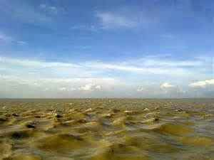
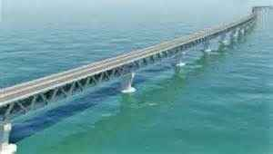
Look at the picture and guess about it.
The Meghna.
The Padma.

Slide 9
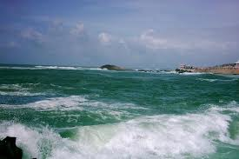
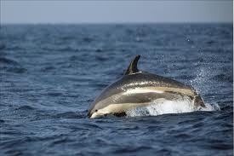
Look at the picture and guess about it.
The Bay of Bengal.
The Atlantic Ocean

Slide 10
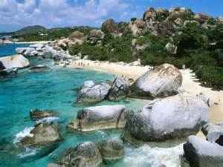
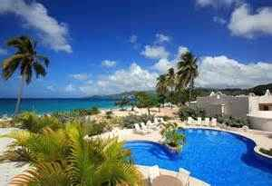
Look at the picture and guess about it.
The Virgin Gorda Island
The Spice Island

Slide 11
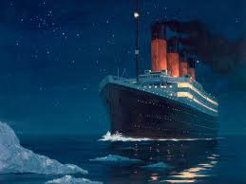
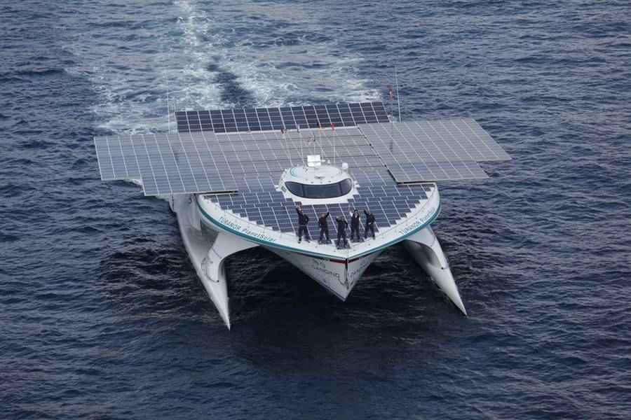
Look at the picture and guess about it.
The Titanic
The Departure Int.

Slide 12
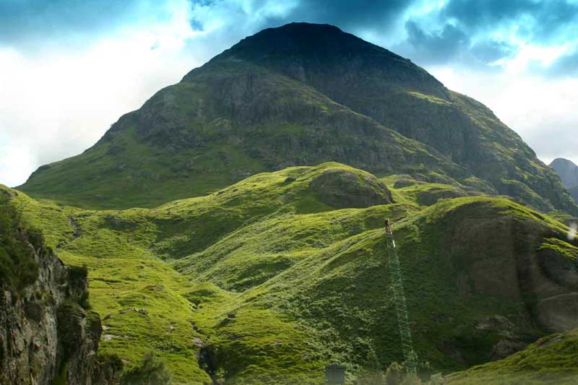
Look at the picture and guess about it.
the Highlands

Slide 13
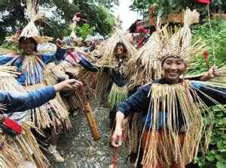
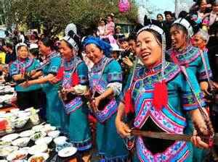
Look at the picture and guess about it.
The Boitsuk Ethnic Group
The Hani Ethnic Group

Slide 14

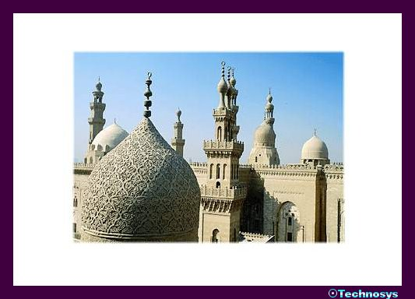
Look at the picture and guess about it.
The Holy Quran
The mosque

Slide 15
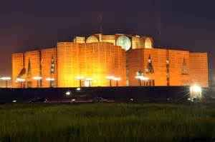
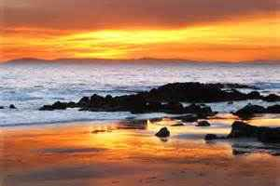
Look at the picture and guess about it.
The Sangsad Bhavan
The west

Slide 16

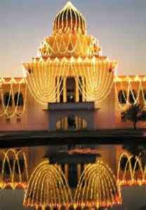
Look at the picture and guess about it.
The News Times
The Supreme Court

Slide 17
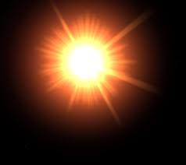
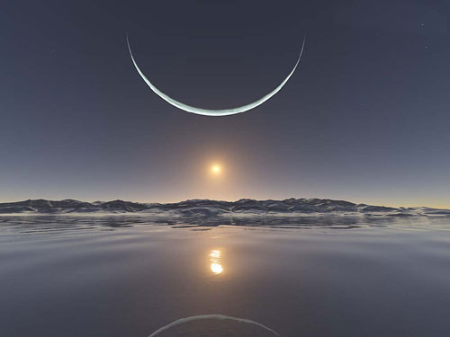
Look at the picture and guess about it.
The sun
The moon

Slide 18
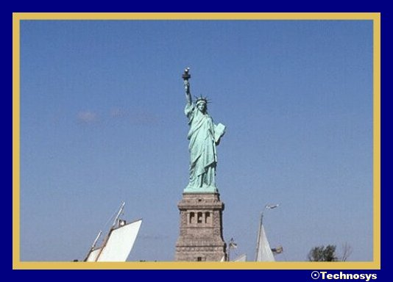
Look at the picture and guess about it.
The Statue of Liberty

Slide 19
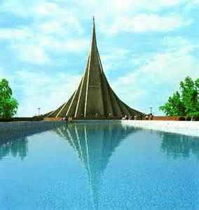
Look at the picture and guess about it.
The National Memorial at Savar.

Slide 20
Rule: “The” is used before public buildings, institutions, means of transportation
Ex: The school that Mamun goes to is old.
The bus to Dhaka leaves at 7.40.
The Pagoda of Myanmar is famous.
Rule 02: “The” is used before names of countries in the plural; mountain ranges; regions.
the United States of America, the Netherlands; the Highlands, the Rocky Mountains, the Alps; the Middle East, the west of Australia

Slide 21
Rule 03: “The” is used before groups of islands.
Ex: the Bahamas, the British Isles, the Canaries
Rule 04: “The” is used before name with of-phrase; oceans; seas; rivers
Ex: the Statue of Liberty, the Isle of Wight; the Atlantic (Ocean);the Mediterranean (Sea); the Nile, the Rhine, the Suez Canal

Slide 22

Rule 05: “The” is used before superlative degree.
Ex: the wisest, the largest, the most beautiful, the richest, the oldest, the greatest etc.
Rule 06: “The” is used before months, days of the week.
Ex: I always remember the Monday when I had an accident.

Slide 23


এবার এসো আমরা ছন্দে ছন্দে the এর ব্যবহার শিখি
নদী,
সাগর,
দ্বীপপুঞ্জ
জাহাজাদি,
গিরিপুঞ্জ,
জাতি,
সম্প্রদায়,
ধর্মগ্রন্থ
কোট,
সিনেট ও
সংবাদপত্র,
তারিখ,
পর্বত ও
দিকের নাম
যত আছে খ্যাত ধাম,
চন্দ্র,
সূর্য,
গ্রহ,
তারা
আরো যত বিশ্বধরা
পৃথিবীতে একটি আছে যত
তার পূর্বে বসে the ব্যাকরণগত।

Slide 24
Group work :
Look at the picture; read the following passage carefully and put the articles where necessary:

Slide 25
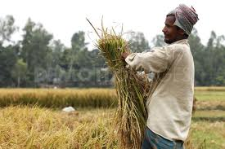

Slide 27
Jamal live in …. village. He has some land. He is working in …… field. His grand father Suruj Mia is ….. cleverest man in his village. He often goes to ….. Meghna to catch fish. He has also a dream to catch fish in ...... Bay of Bengal. Last year he went to Dhaka to see ….. National Memorial at Savar.

Slide 28
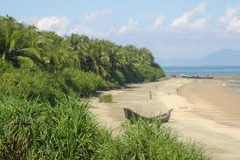
Evaluation :
The Saint Martin Island is ….. smallest union in Bangladesh.

Slide 29
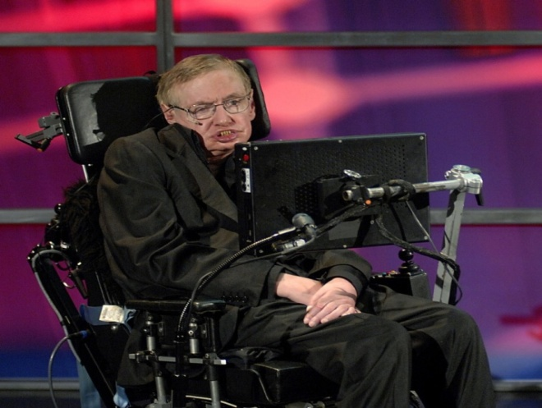
Stephen Hawking is one of ----- greatest scientists in the world.

Slide 30

Home work :
1. What is the definition of definite article?
2. Write some nouns where use the definite article the?
3. What is inserted before superlative
degree?

Slide 31
